Slide 1
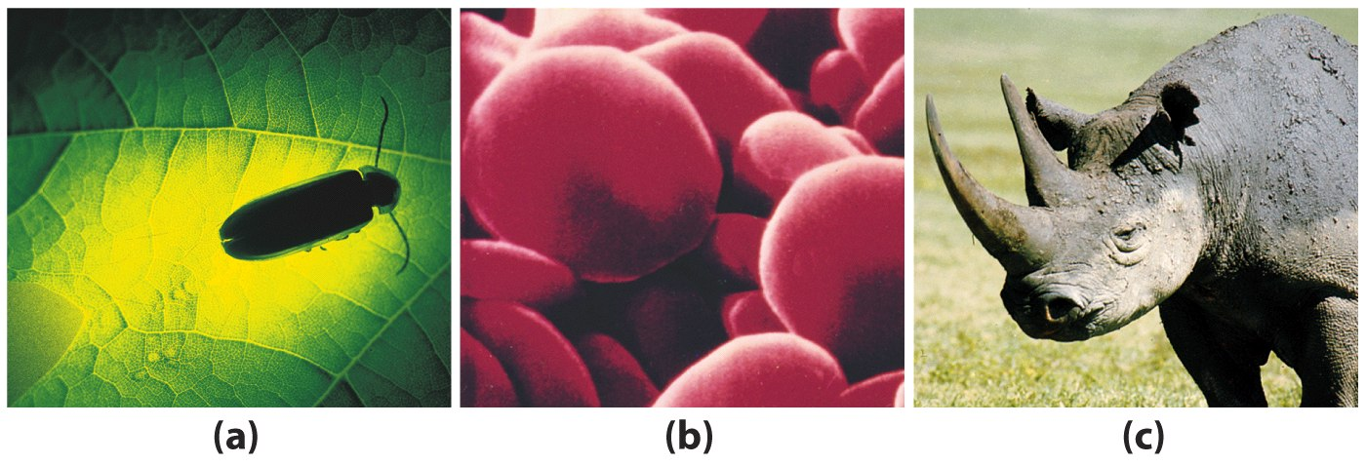
Proteins: Enzymes, Binding Proteins, Structural Proteins – all made from Amino Acids
Light from the enzyme, Luciferase, that uses a chemical reaction to produce light. Enzyme named for Lucifer of Greek Mythology, the bearer of light that lights up the first and other evening stars. Not the Lucifer of Christian Mythology.
Hemoglobin (Hb) an oxygen binding protein.
Skin, horns, nails, hair, claws, feathers….all different forms of keratin, a structural protein.
Notes:
Light from the enzyme, Luciferase, that uses a chemical reaction to produce light. Enzyme named for Lucifer of Greek Mythology, the bearer of light that lights up the first and other evening stars. Not the Lucifer of Christian Mythology.
Hemoglobin (Hb) an oxygen binding protein.
Skin, horns, nails, hair, claws, feathers….all different forms of keratin, a structural protein.

Slide 2
Amino Acids: Building Blocks of Protein
Proteins are linear heteropolymers of α-amino acids
Amino acids have properties that are well-suited to carry out a variety of biological functions
Capacity to polymerize
Useful acid-base properties
Varied physical properties
Varied chemical functionality

Slide 3
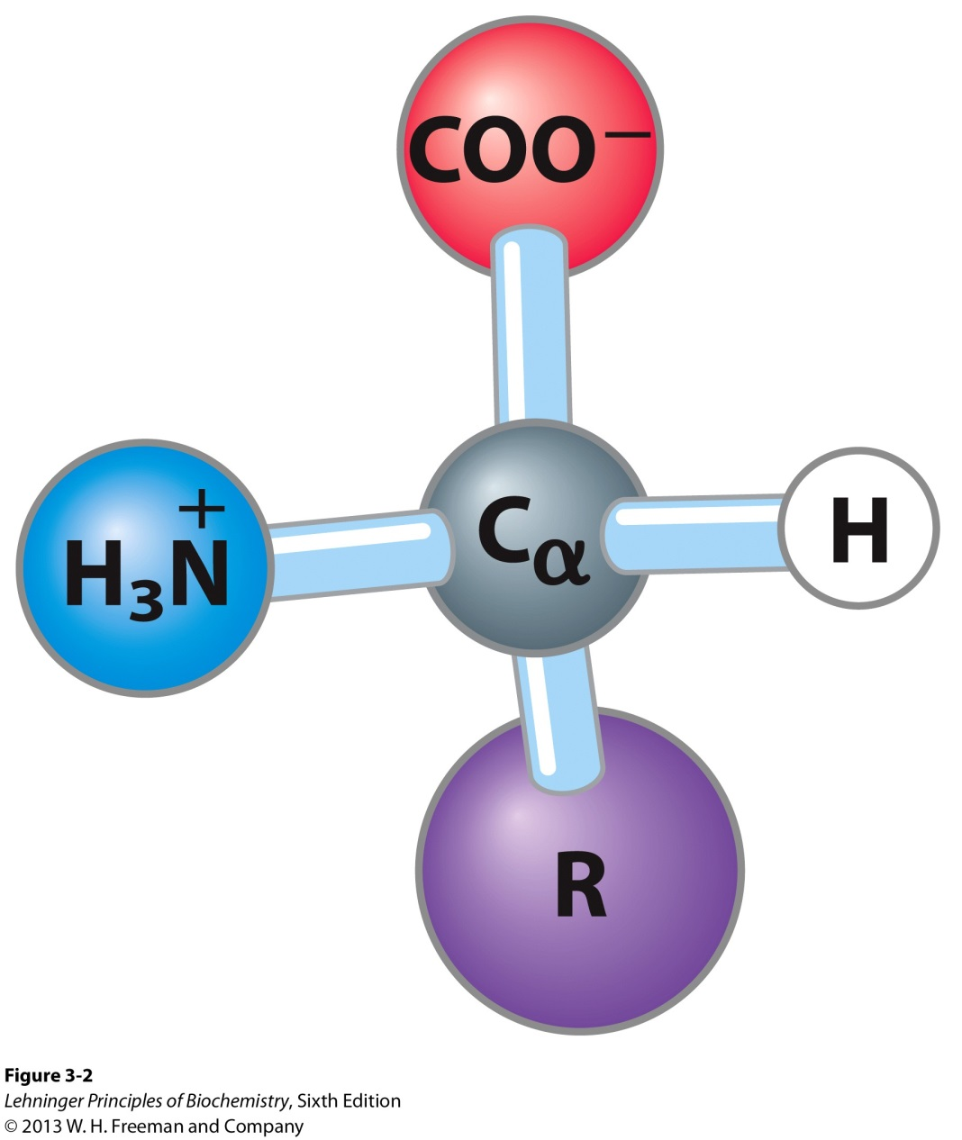
Amino acids share many features, differing only at the R substituent
This structure is common to all but one of the α-amino acids. (Proline, a cyclic amino acid, is the exception.) The R group, or side-chain (red), attached to the α carbon (blue) is different in each amino acid.
Notes:
FIGURE 3-2 General structure of an amino acid. This structure is common to all but one of the α-amino acids. (Proline, a cyclic amino acid, is the exception.) The R group, or side-chain (red), attached to the α carbon (blue) is different in each amino acid.

Slide 4
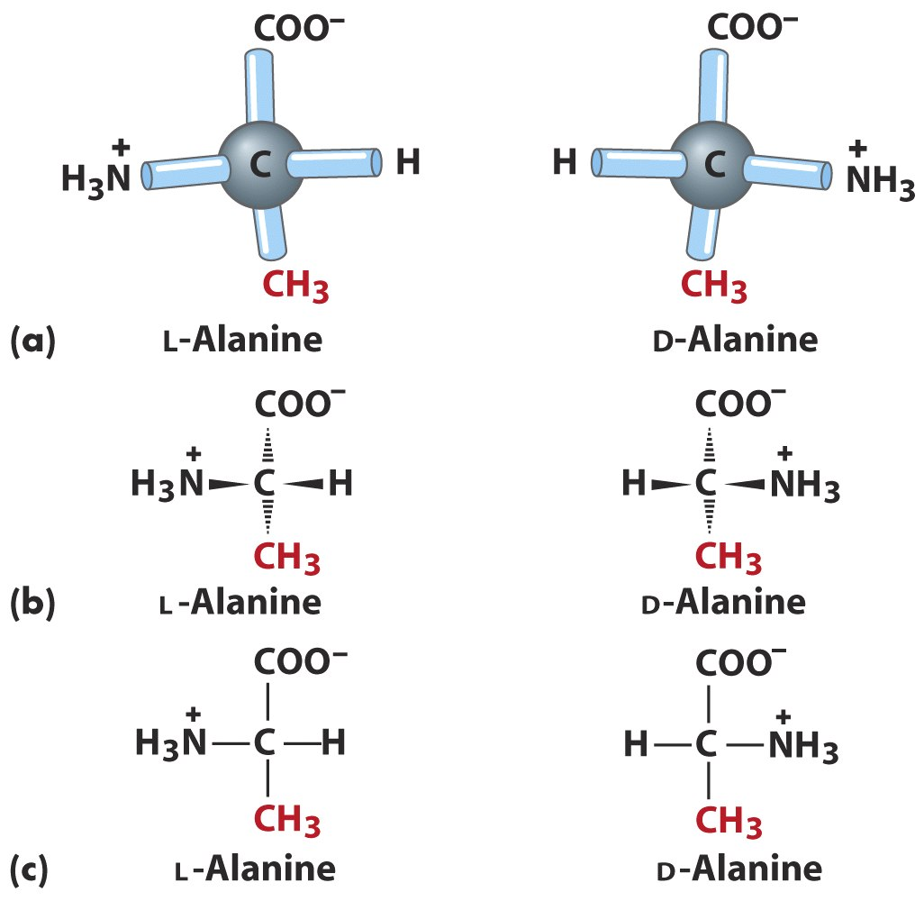
L and D forms
Notes:
Yes, we still use L and D.

Slide 5
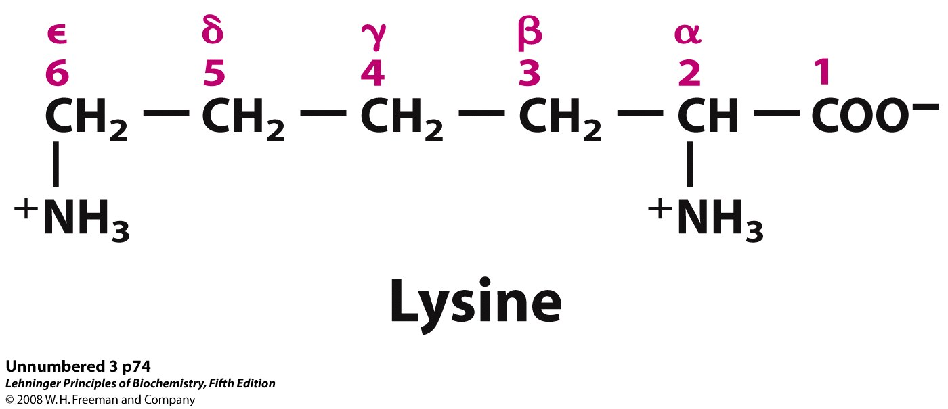
Carbon Numbering System
A
Notes:
Review

Slide 6
Amino Acids: Classification
Common amino acids can be placed in five basic groups depending on their R substituents:
Nonpolar, aliphatic (7)
Aromatic (3)
Polar, uncharged (5)
Positively charged (3)
Negatively charged (2)

Slide 7
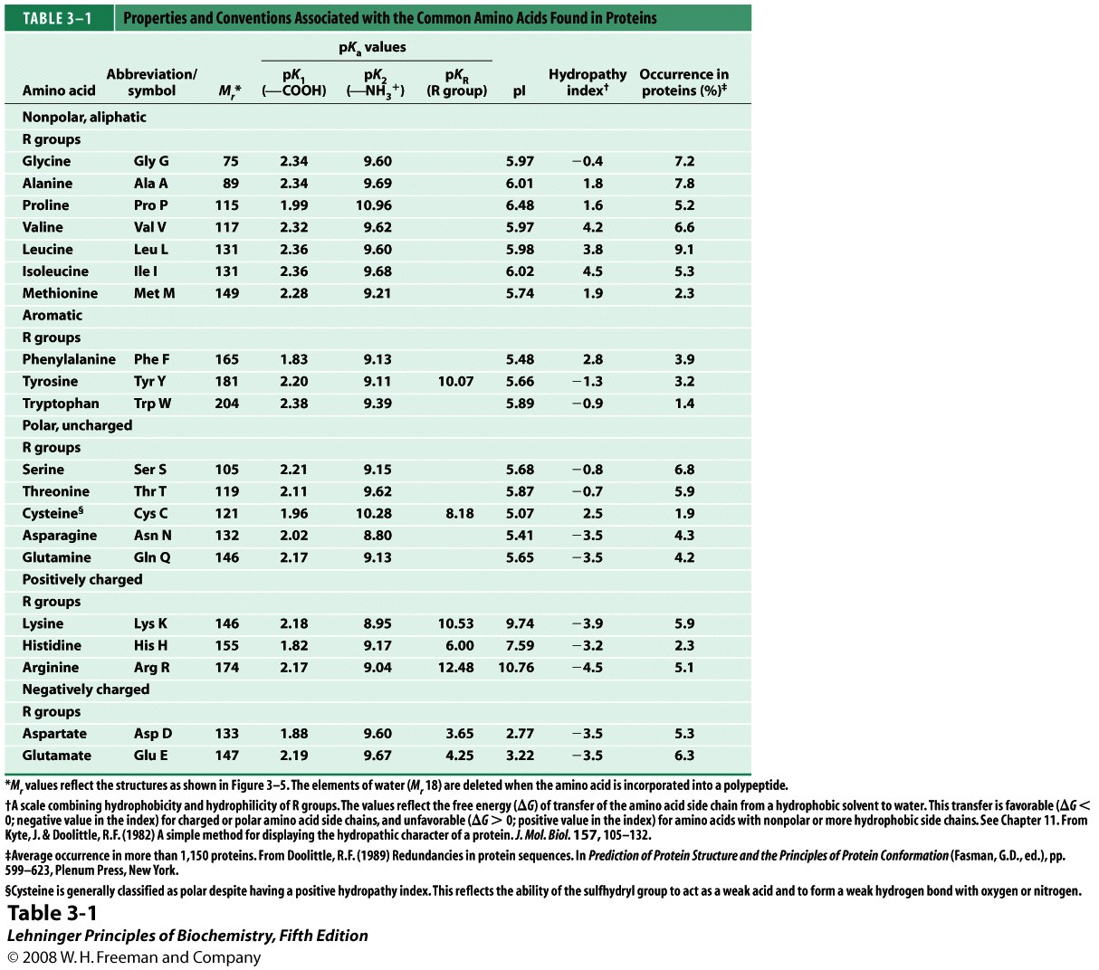
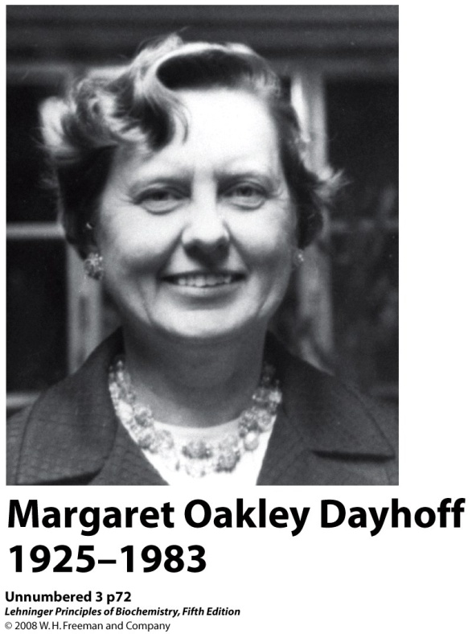
Invented the One Letter Amino Acid Code.
Notes:
Yes, you have to know the one letter symbol for each amino acid.

Slide 8
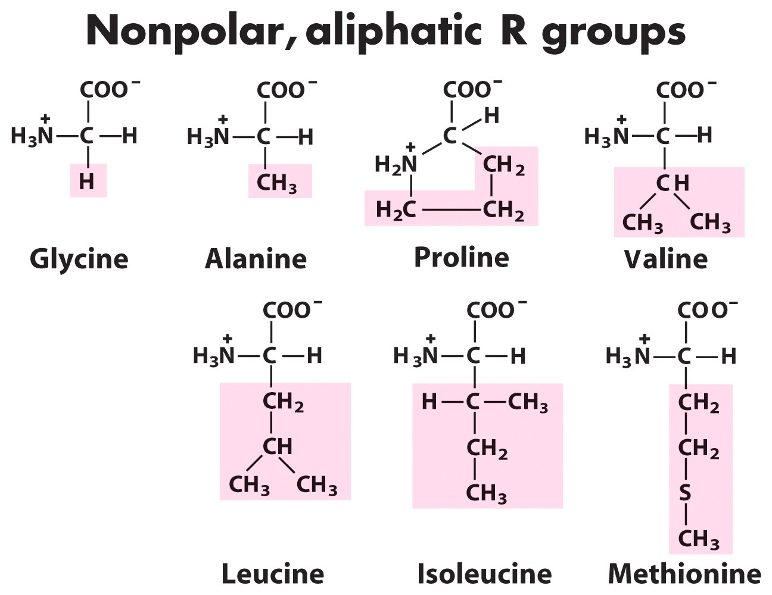
Notes:
Why isn’t proline a really “true” amino acid?
Yes you have to know their structures.

Slide 9
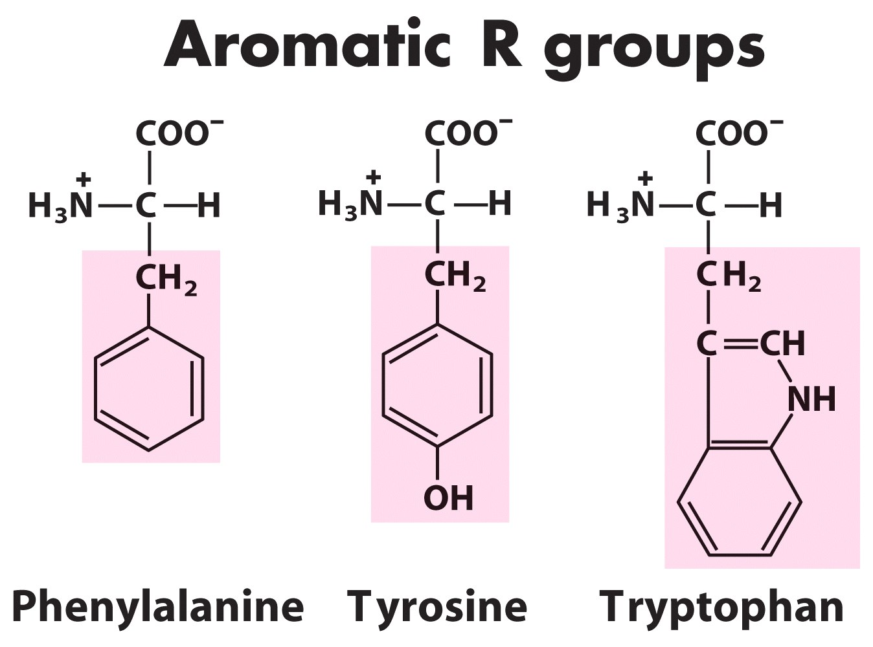
Notes:
Only three aromatics.

Slide 10
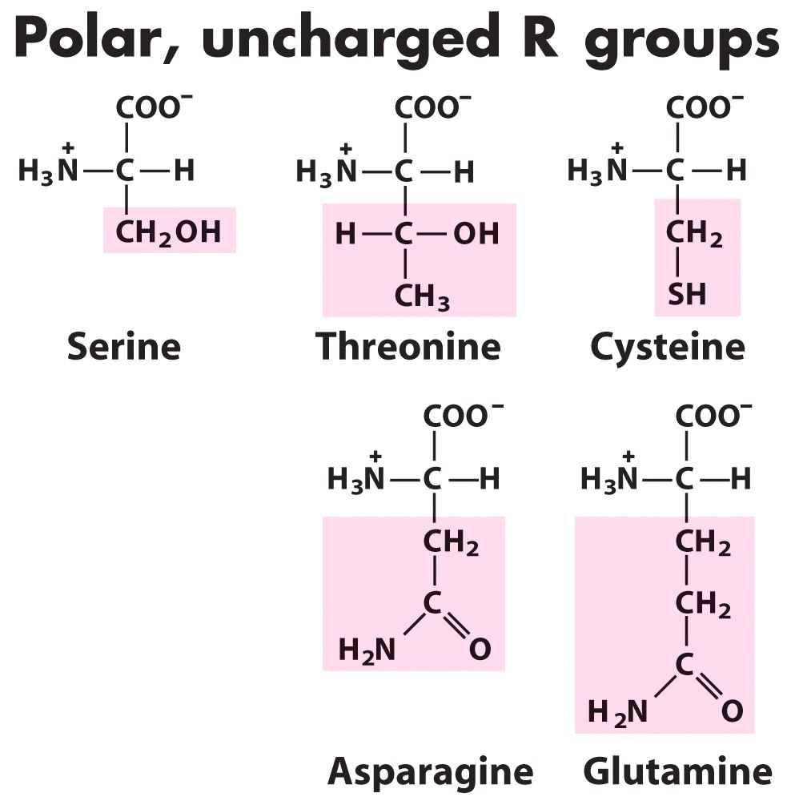
Notes:
Why are these polar?

Slide 11
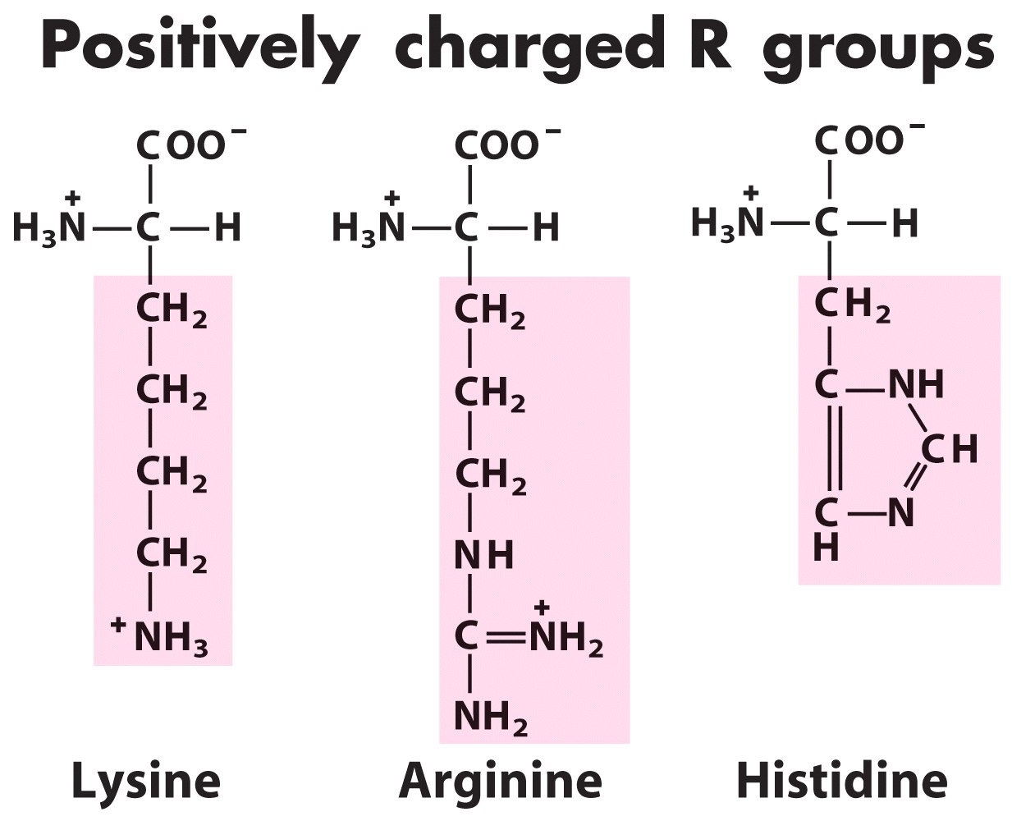
Notes:
Only three basic amino acids.

Slide 12
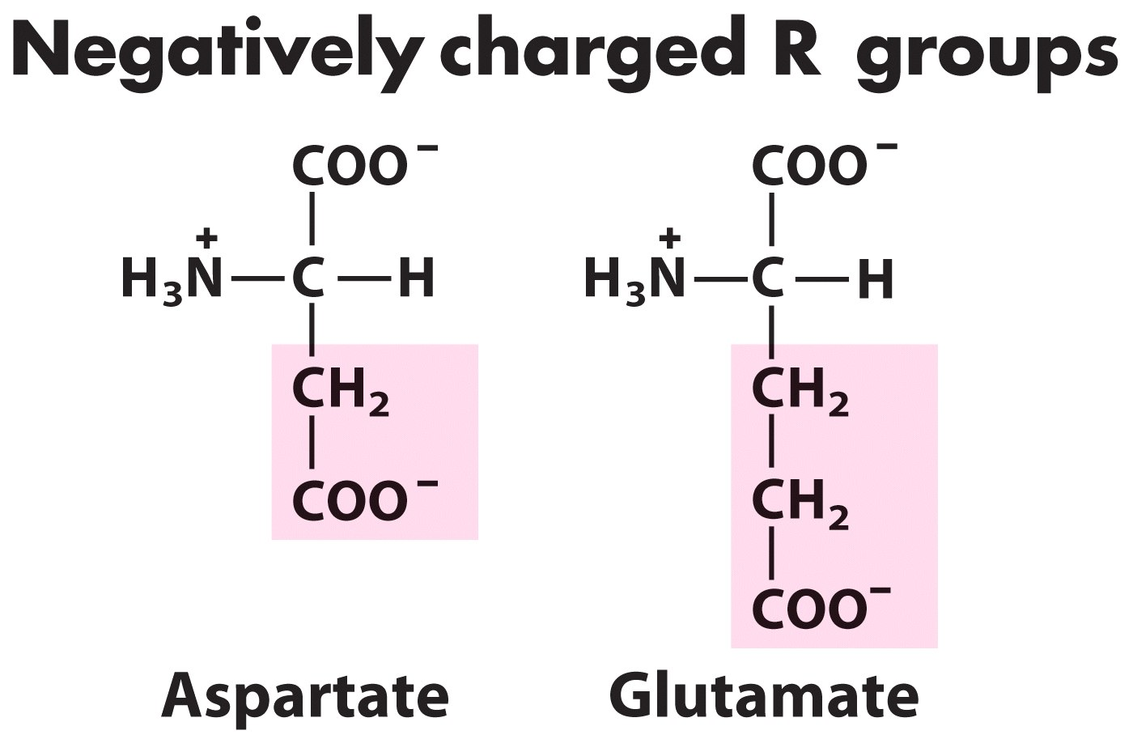
Notes:
Only two acidic amino acids. Note that these are related to the amide amino acids: asparagine and glutamine.

Slide 13
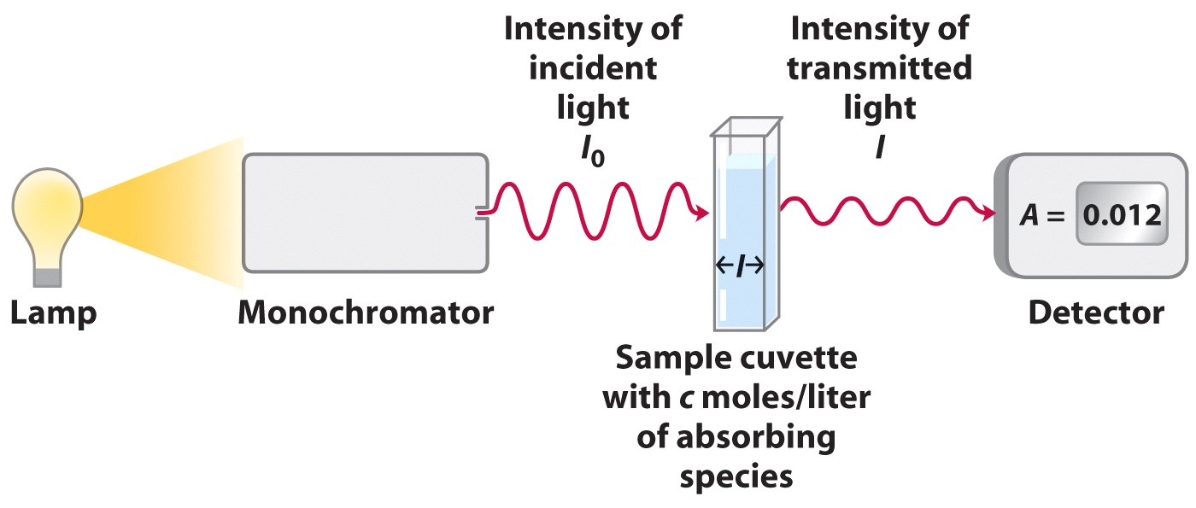
Spectrophotometry
Notes:
UV spectrophotometry is a easy, non-destructive way of measuring proteins, next slide.

Slide 14
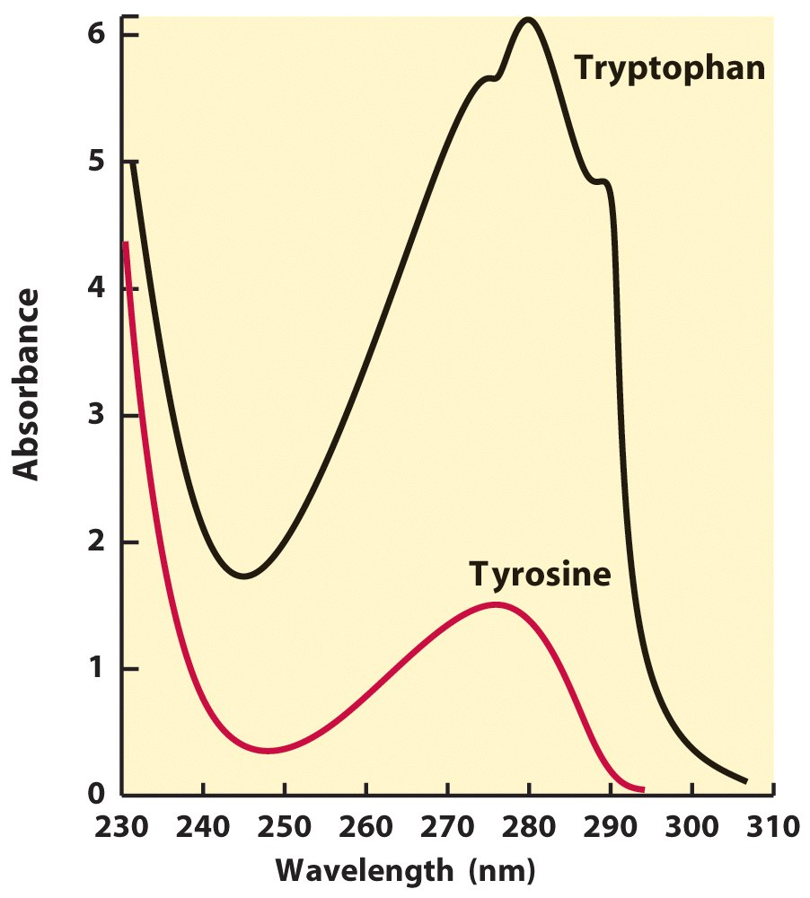
UV light Absorption by Proteins – due to 2 Amino Acids
Notes:
Amino acid, F, has some 280 nm absorbance but it is small considering these two.

Slide 15
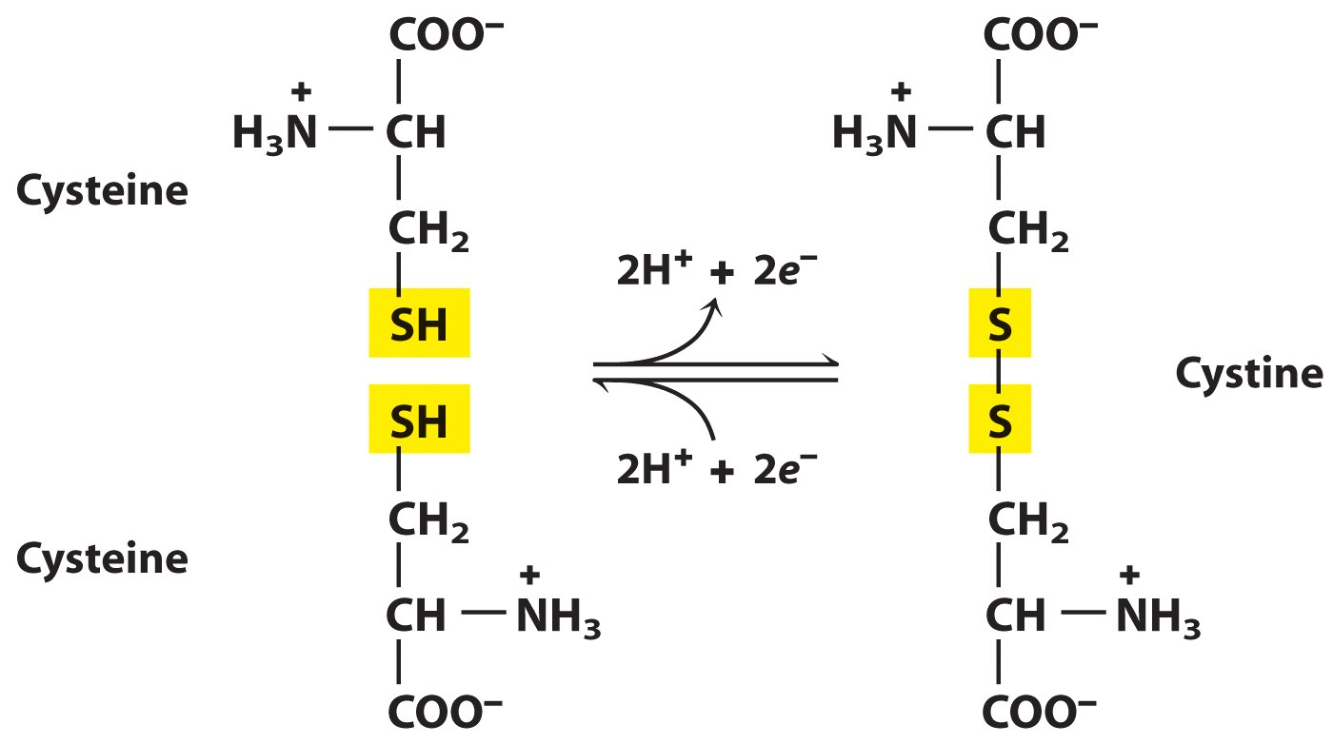
Cysteine can form Disulfide Bonds
Notes:
Cysteines can form disulfide bonds…entirely important in protein structure. It is a covalent bond that can be broken by reduction and made by oxidation.

Slide 16
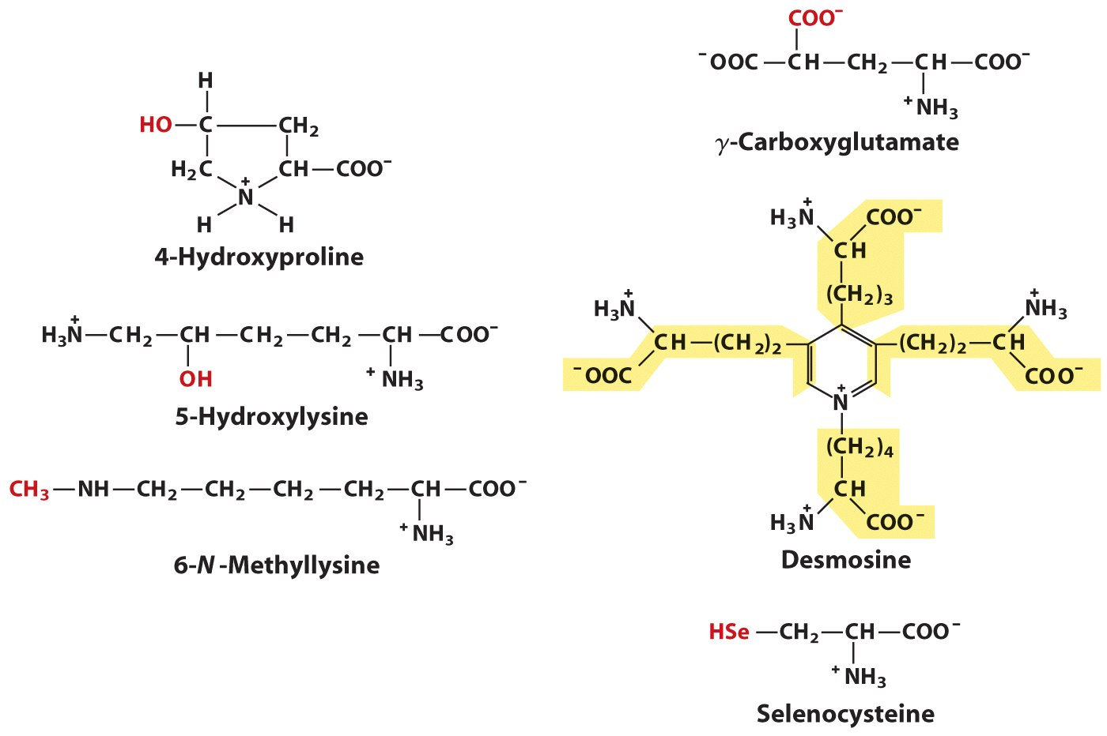
Uncommon Amino Acids
Notes:
Some of these are amino acids in proteins which are modified after translation.

Slide 17
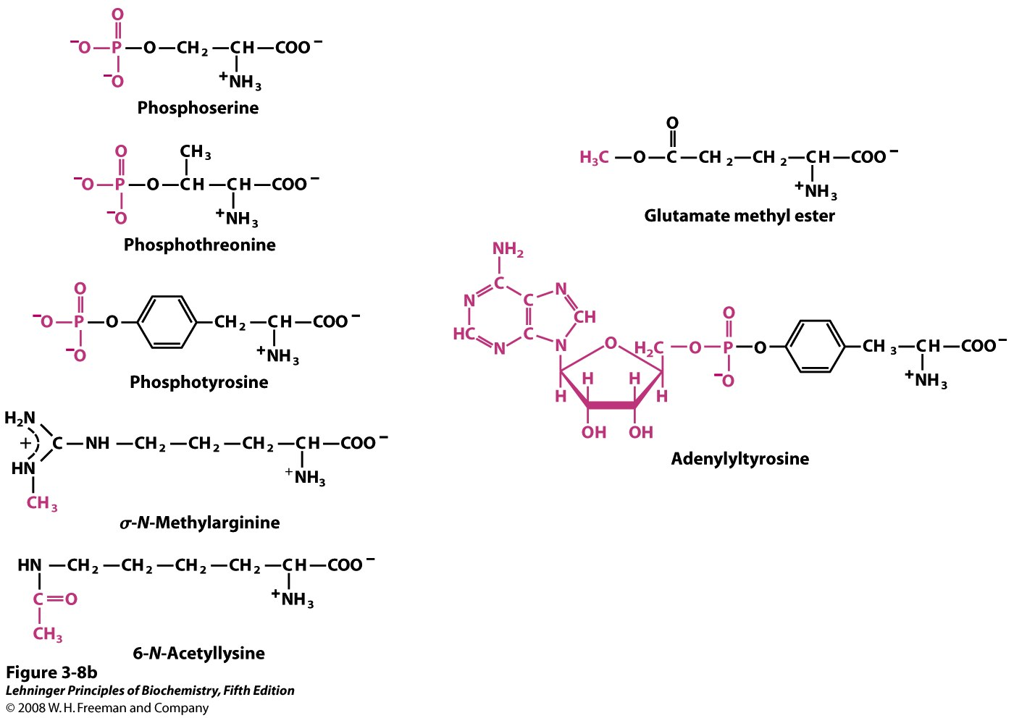
Amino acids in Proteins Can be Reversibly Modified
A

Slide 18
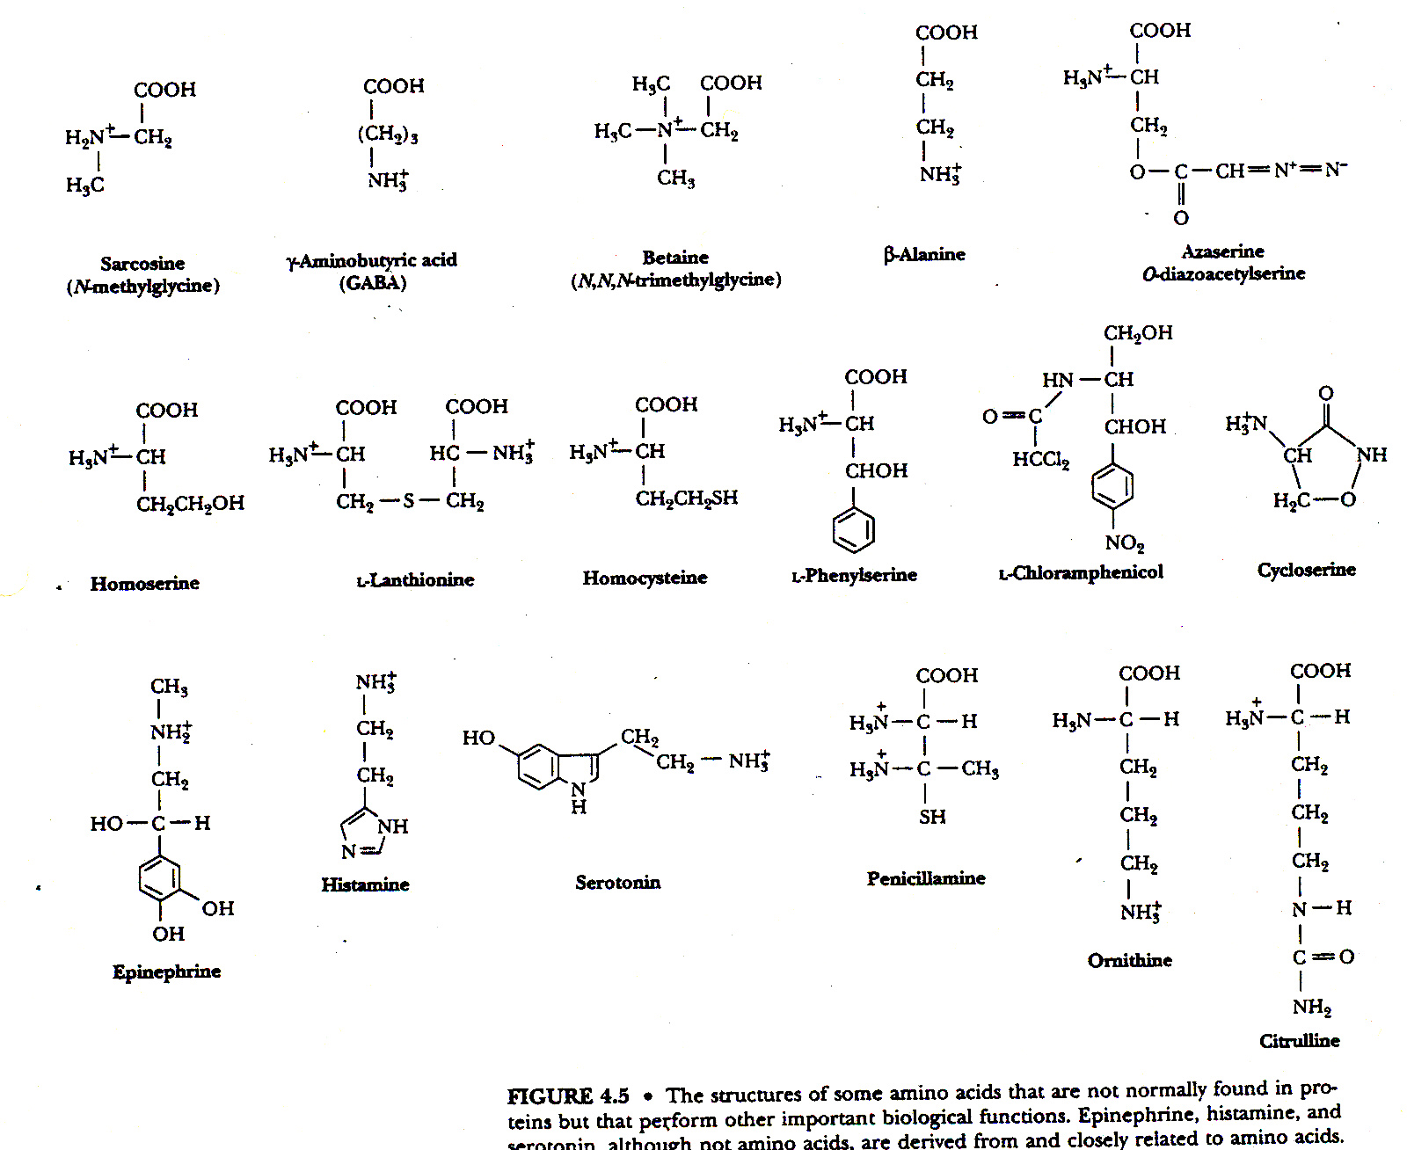
Non Protein Amino Acids
Notes:
You don’t have to know the structures, but do have to know that these are important metabolites. Some are antibiotics. Some are hormones and some are important immune modulators.

Slide 19
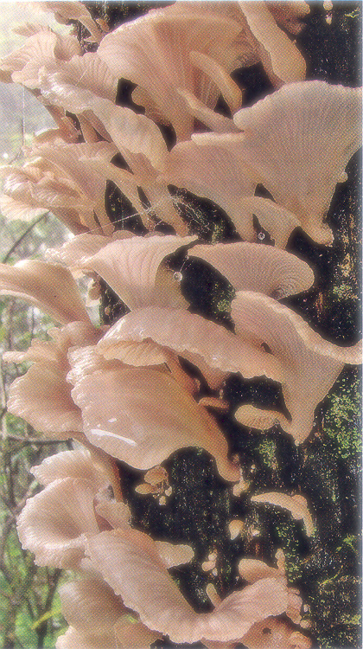
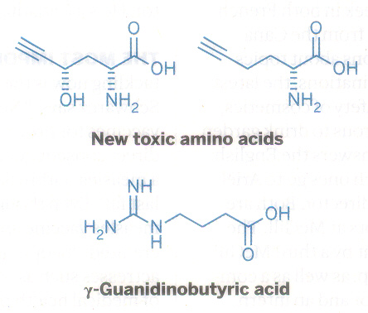
Toxic Amino Acids
A search for compounds producing Yunnan Sudden Unexplained Deaths found related to eating a mushroom.
Halford, B. C+E News Feb 13, 2012
Trogia venenata Zhu L
Notes:
Toxins too !

Slide 20
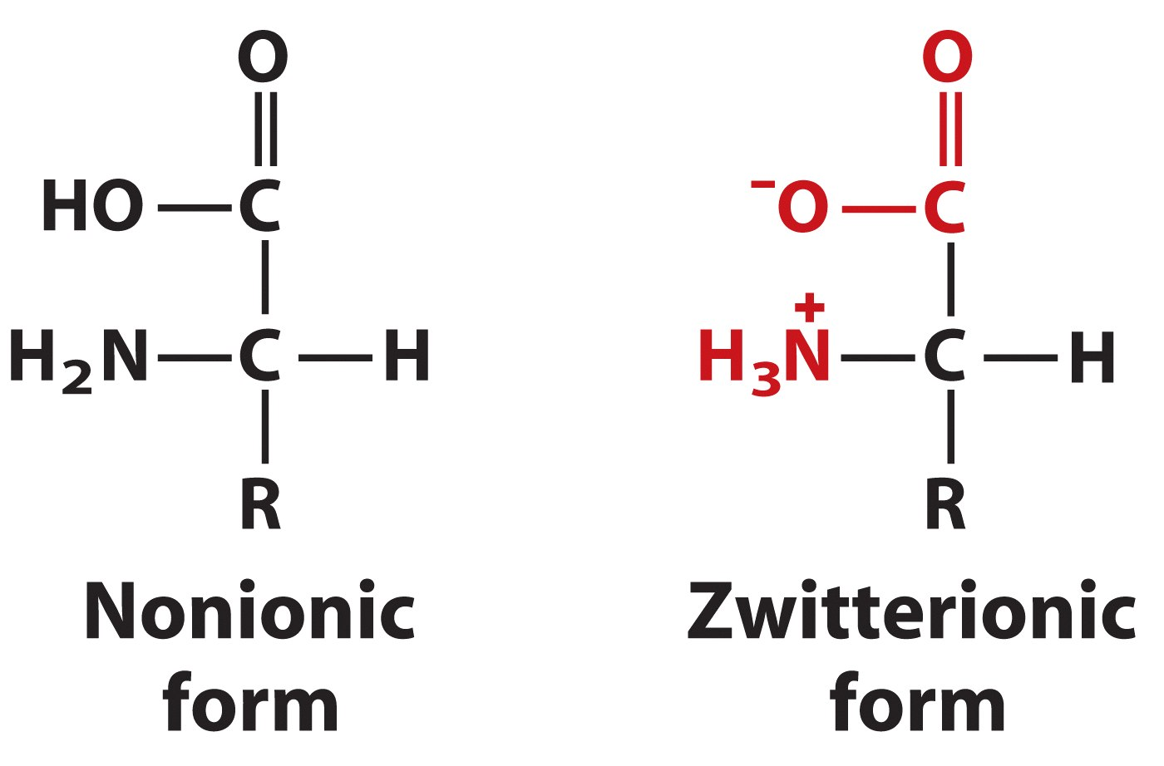
Which Form Occurs in Water ?
Notes:
Which form occurs in Organic Chemistry texts?

Slide 21
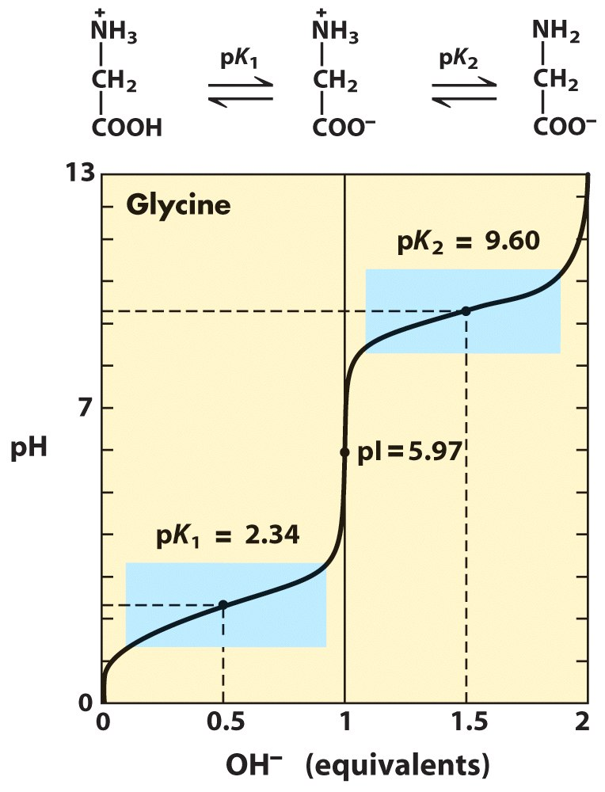
Glycine Acid/Base Titration
Notes:
Oh, this is easy, we did it a chapter ago. Be sure to know which are the equivalence points. pI is the isoelectric point when the net charge on the molecule is zero. It is an easy number to calculate: pI = (pK_{a} + pK_{b}) / 2. Note that the subscripts a and b are between amino acid pK’s where the net charge is zero. It is interesting to find the pI of amino acids with acidic and basic R groups.

Slide 22
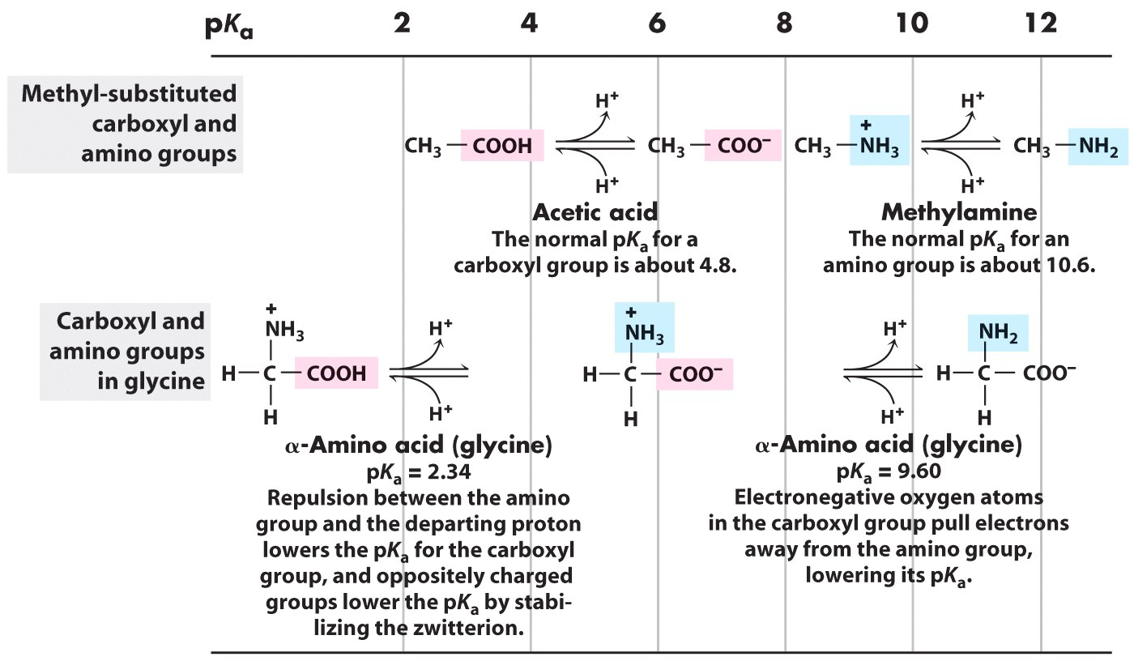
Compare Amino Acids to Simple Carboxylic Acids and Amines
Notes:
Why is glycine so much a stronger weak acid than acetic acid ? And, not as pronounced, but glycine’s amino is a stronger acid than that of methylamine.

Slide 23
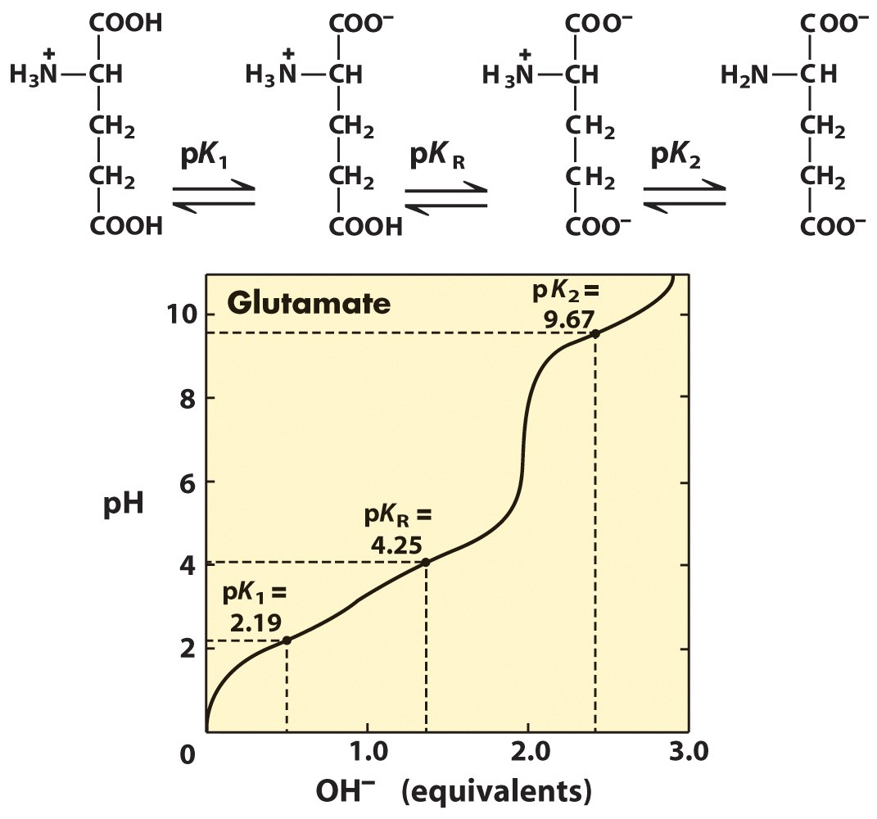
Glutamate has 3 pKa’s
Notes:
What is the Isoelectric point ?.....is it at an equivalence point or pKa? Think about it.

Slide 24
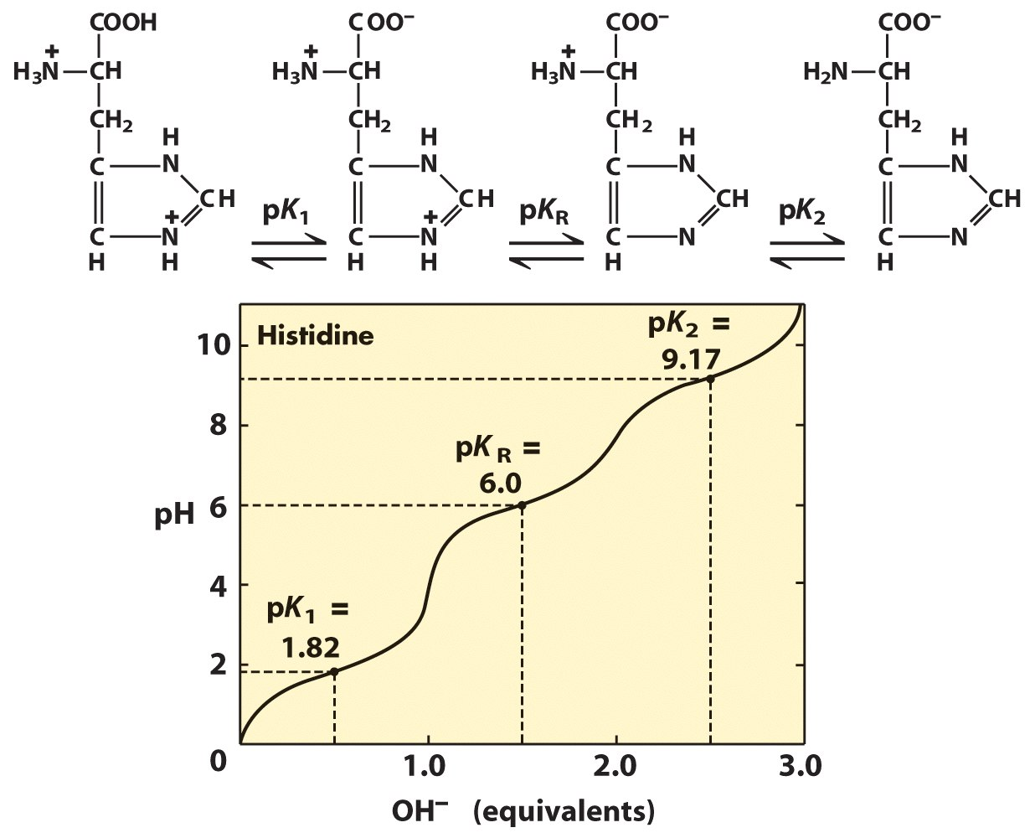
Histidine has 3 pKa’s
Notes:
What is the isoelectric point ?

Slide 25
How to Calculate the pI When the Side Chain is Ionizable
Identify species that carries a net zero charge
Identify pK_{a} value that defines the acid strength of this zwitterion: (pK₂)
Identify pK_{a} value that defines the base strength of this zwitterion: (pK₁)
Take the average of these two pK_{a} values
What is the pI of histidine?

Slide 26
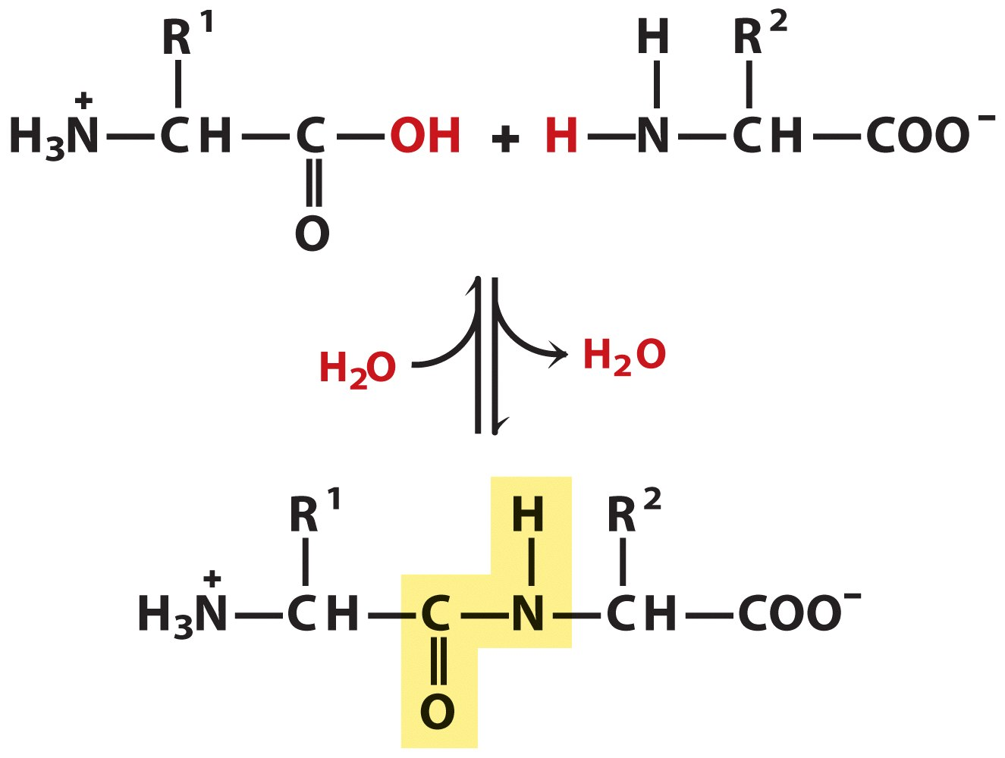
Peptide Bond Formation
Where does this occur? Where does this occur?
Peptide bond formation (dehydration) occurs on the ribosome. Peptide bond breaking is the key to protein digestion (small intestine) and in the cytoplasm of every living cell as protein turnover.
Notes:
Peptide bond formation (dehydration) occurs on the ribosome. Peptide bond breaking is the key to protein digestion (small intestine) and in the cytoplasm of every living cell as protein turnover.
Note that the peptide bond is trans.

Slide 27
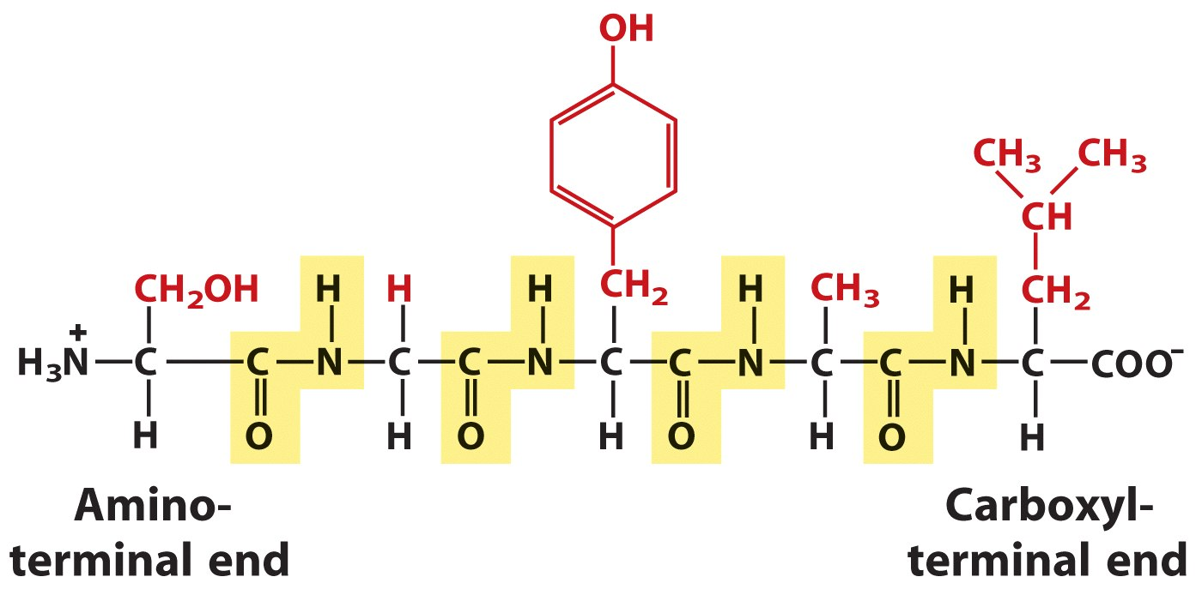
Structure of a Simple Peptide
Ser-Gly-Tyr-Ala-Leu or SGYAL
Notes:
What is the charge of this peptide at pH 0? at pH 7? at pH 12?
Note that the peptide bond is trans.

Slide 28
Naming peptides: start at the N-terminus
Using full amino acid names
Serylglycyltyrosylalanylleucine
Using the three-letter code abbreviation
Ser-Gly-Tyr-Ala-Leu
For longer peptides (like proteins) the one- letter code can be used
SGYAL

Slide 29
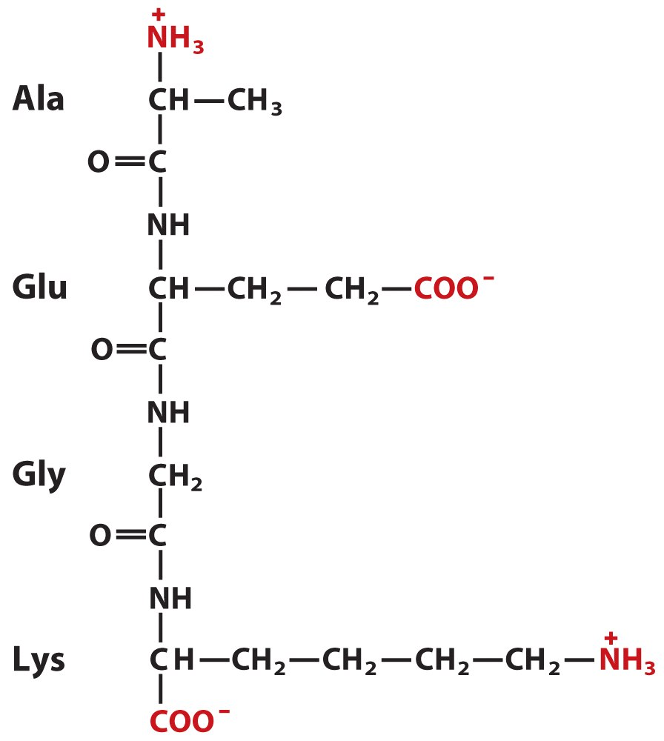
AEGK
Notes:
Play the pH game with this peptide too.

Slide 30
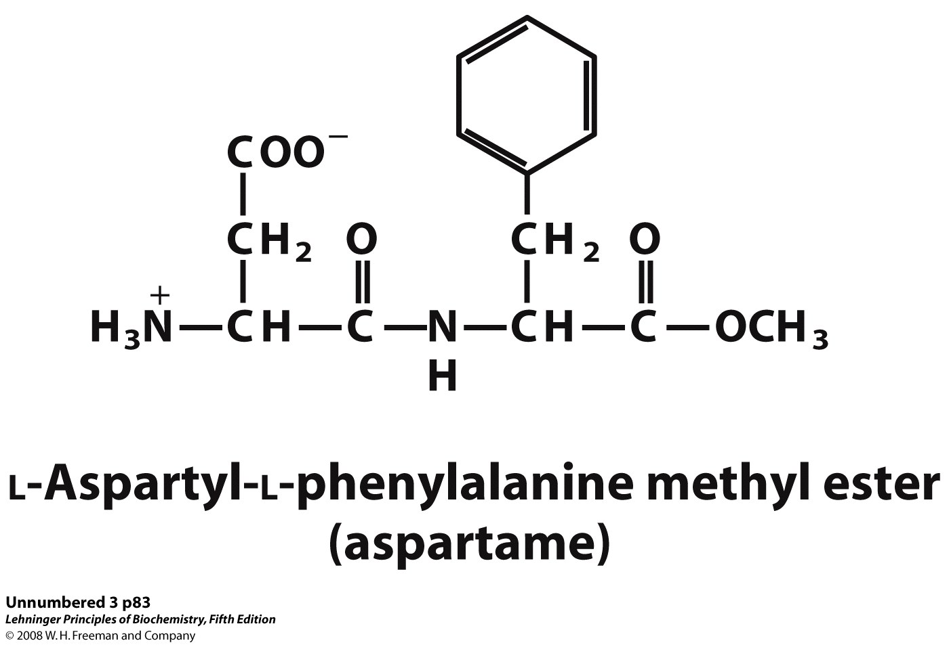
Aspartame
A
Notes:
We will come back to this molecule when we get to sugars and other molecules that are sweet.

Slide 31
Peptides: A Variety of Functions
Hormones and pheromones
insulin (think sugar)
oxytocin (think childbirth)
sex-peptide (think fruit fly mating)
Neuropeptides
substance P (pain mediator)
Antibiotics
polymyxin B (for Gram – bacteria)
bacitracin (for Gram + bacteria)
Protection, e.g., toxins
amanitin (mushrooms)
conotoxin (cone snails)
chlorotoxin (scorpions)

Slide 32
Proteins are:
Polypeptides (covalently linked α-amino acids) + possibly:
cofactors
functional non-amino acid component
metal ions or organic molecules
coenzymes
organic cofactors
NAD⁺ in lactate dehydrogenase
prosthetic groups
covalently attached cofactors
heme in myoglobin
other modifications

Slide 33
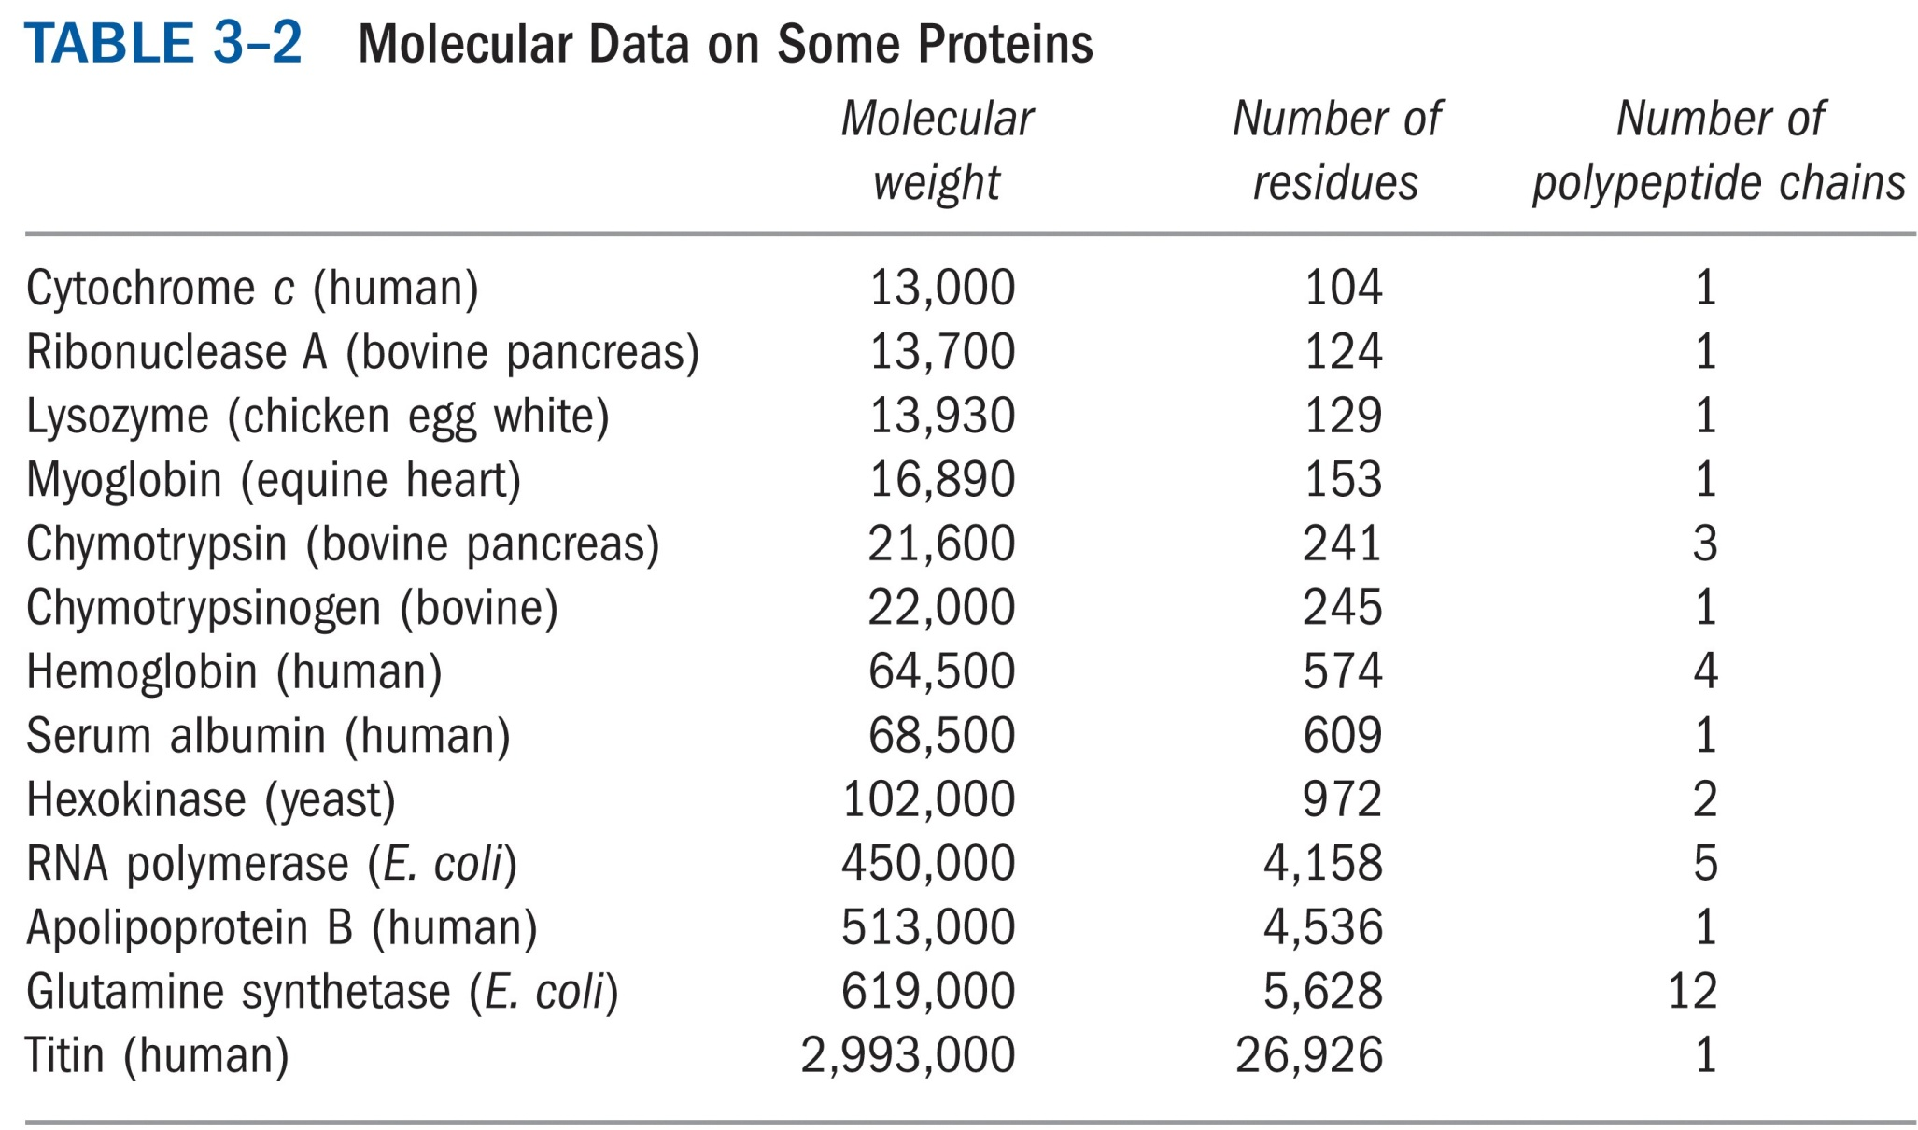
Notes:
Protein come in small sizes ~ 10kD to enormous, titin is almost 3 million D, and one to many polypeptides. How many N-terminal amino acids does Escherichia coli’ RNA polymerase have?

Slide 34
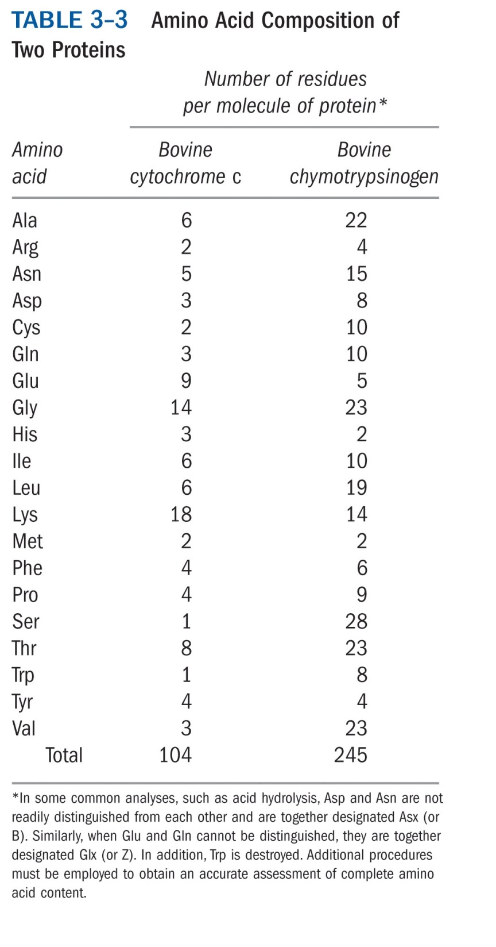
Notes:
Each protein has it’s own distinctive amino acid composition.

Slide 35
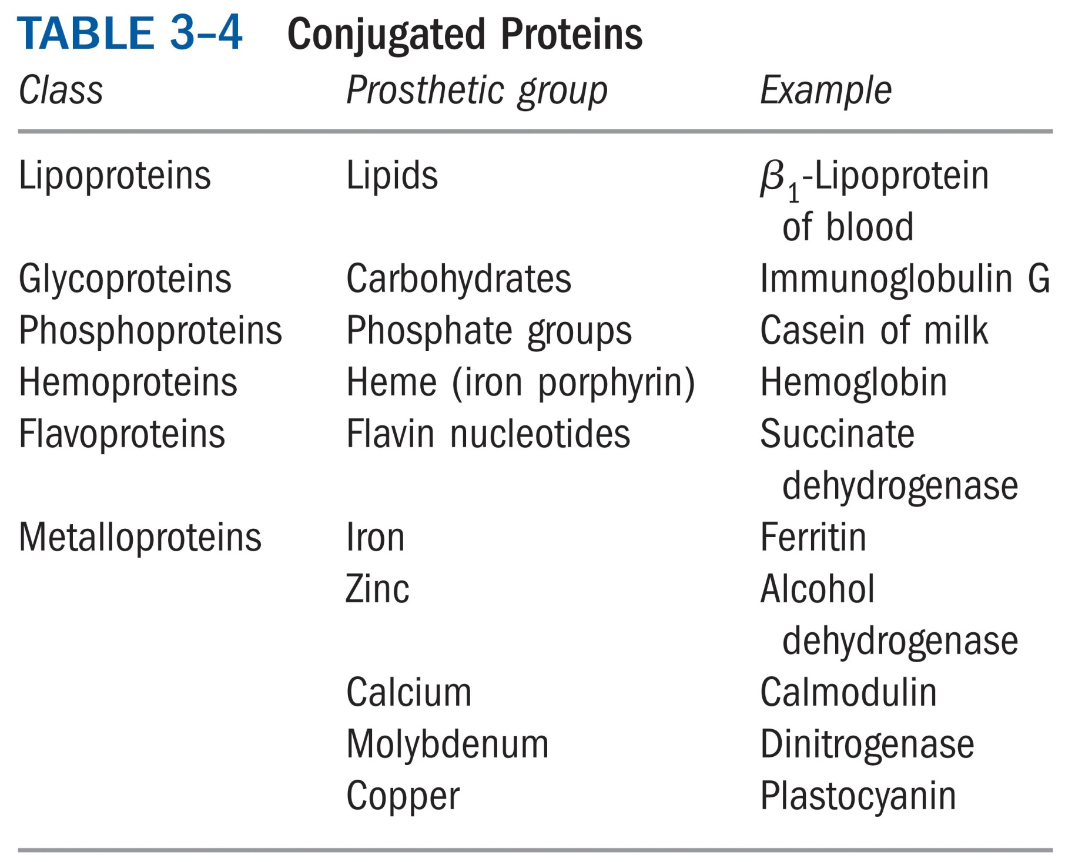
Notes:
Many proteins like to be attached to something else.

